Slide 1

Project Title - Seasonal Agriculture Performance Analysis
Name – Sakshi Sandip Gomase
College – Sanjivani College Of Engineering, Kopargaon
AICTE STU ID : STU698d6919884ad1770875161

Slide 2

PROBLEM STATEMENT
Agricultural activities are influenced by seasonal variations in environmental conditions, farming practices, resource availability and market conditions. As a result, agricultural performance may differ from one season to another.
However, raw agricultural data does not clearly explain how agricultural performance changes across seasons or what patterns can be observed in different seasonal conditions.
The problem is to analyze the given agricultural dataset and investigate seasonal differences in agricultural performance by identifying meaningful patterns, trends, relationships and variations within the available data.

Slide 3
Project Description
Seasonal Agriculture Performance Analysis is a data analytics project focused on analyzing agricultural performance across different seasons, geographical areas, farming practices, environmental conditions, resource usage, and economic outcomes. The project uses agricultural data to identify seasonal patterns, trends, relationships, and variations in crop yield and profitability. The project involves data cleaning and preprocessing, exploratory data analysis, statistical analysis, and data visualization using Python. Various visualizations such as bar charts, line charts, box plots, scatter plots, and heatmaps are used to compare seasonal performance and understand relationships between environmental factors, resource utilization, crop production, and economic performance. Statistical techniques such as correlation analysis, ANOVA, and Kruskal-Wallis testing are applied to identify significant differences and relationships in the dataset. The analysis provides evidence-based insights that can support better understanding of seasonal agricultural performance and help in effective farming and seasonal planning.

Slide 4

WHO ARE THE END USERS?
The main end users of the Seasonal Agriculture Performance Analysis project are:
Farmers – To understand seasonal crop performance, resource usage, yield, and profitability.
Agricultural Planners – To use seasonal trends and patterns for better agricultural planning and decision-making.
Agricultural Researchers – To study relationships between environmental conditions, farming practices, crop yield, and seasonal variations.
Government & Agricultural Departments – To support evidence-based agricultural policies, resource planning, and seasonal strategies.
Agribusinesses – To analyze crop production, economic performance, and seasonal trends for business planning.
Primary End Users: Farmers, agricultural planners, and agricultural researchers.

Slide 5

Technology Used
Programming Language: Python
Development Environment: Jupyter Notebook
Libraries: Pandas, NumPy, Matplotlib, Seaborn, SciPy
Data Analysis: Pandas, NumPy
Data Visualization: Matplotlib, Seaborn
Statistical Analysis: SciPy
Data Storage: CSV files
Version Control: Git and GitHub

Slide 6
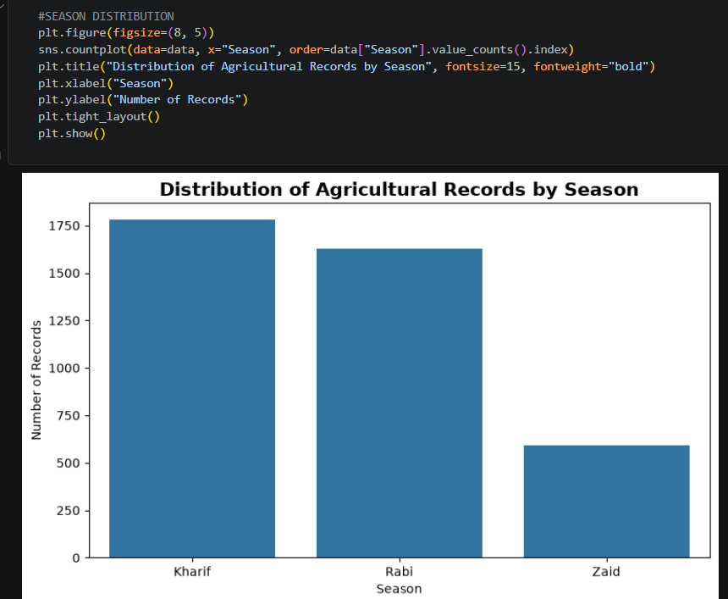
RESULTS
The bar graph shows the distribution of agricultural records across three seasons: Kharif has the highest number of records (around 1,780), followed by Rabi (around 1,630), while Zaid has the lowest number (around 590). This indicates that the dataset contains significantly more records for the Kharif and Rabi seasons compared to the Zaid season.

Slide 7
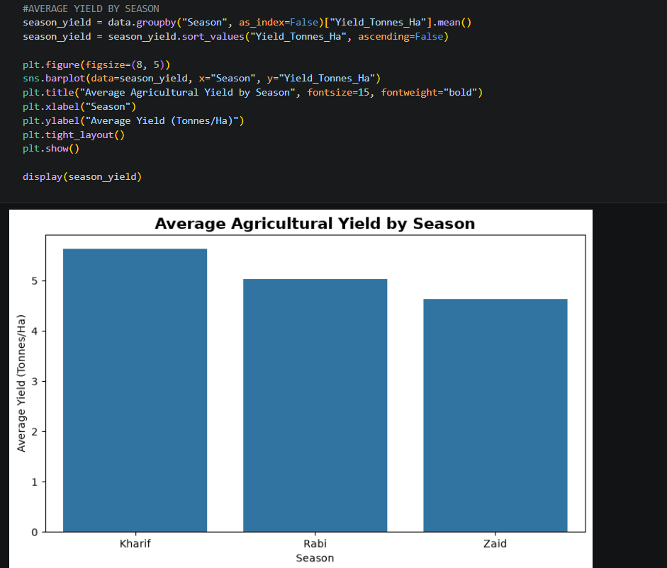
RESULTS
The bar graph shows the average agricultural yield for each season. Kharif has the highest average yield at about 5.6 tonnes/ha, followed by Rabi at around 5.0 tonnes/ha, while Zaid has the lowest average yield at about 4.6 tonnes/ha. Overall, Kharif has the best average agricultural yield among the three seasons.

Slide 8
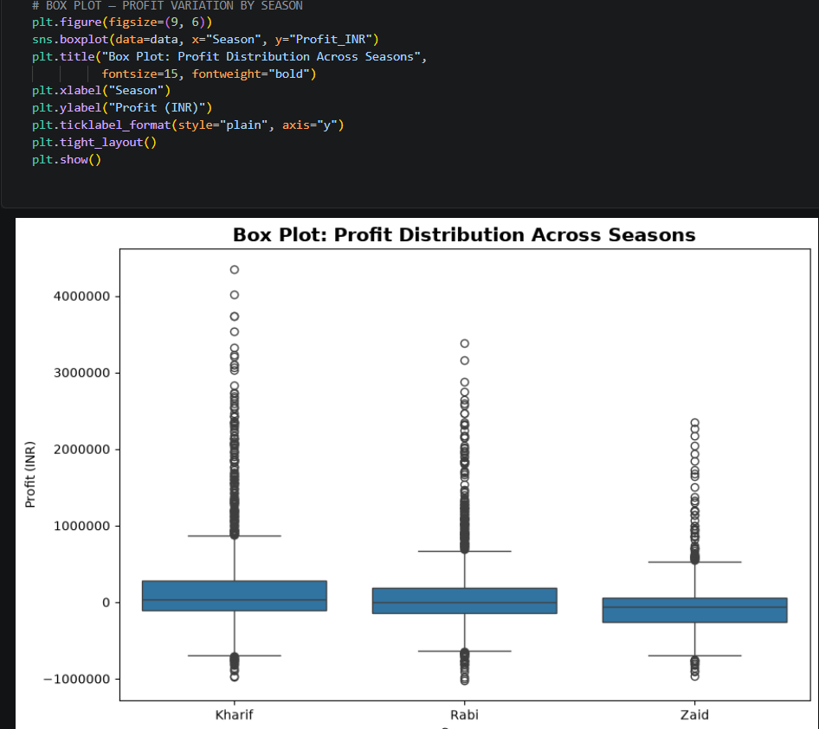
RESULTS
The box plot shows the profit distribution across Kharif, Rabi, and Zaid seasons. Kharif has the highest profit range and variation, followed by Rabi. Zaid generally has lower profits compared to the other seasons. The dots represent outliers, showing unusually high or low profit values.

Slide 9
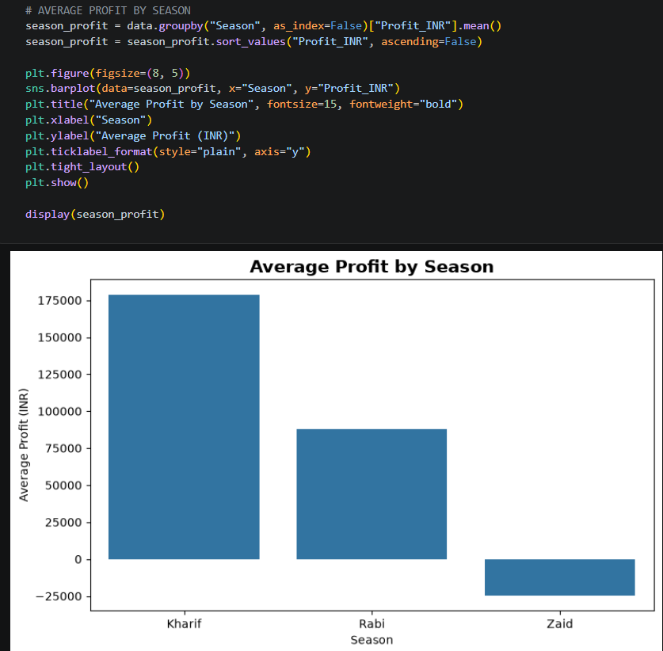
RESULTS
The bar graph shows the average profit for each farming season. Kharif has the highest average profit of about ₹18,000, followed by Rabi with around ₹9,000. Zaid has a negative average profit of about –₹2,500, indicating a loss on average. Overall, Kharif is the most profitable season, while Zaid performs the weakest.

Slide 10
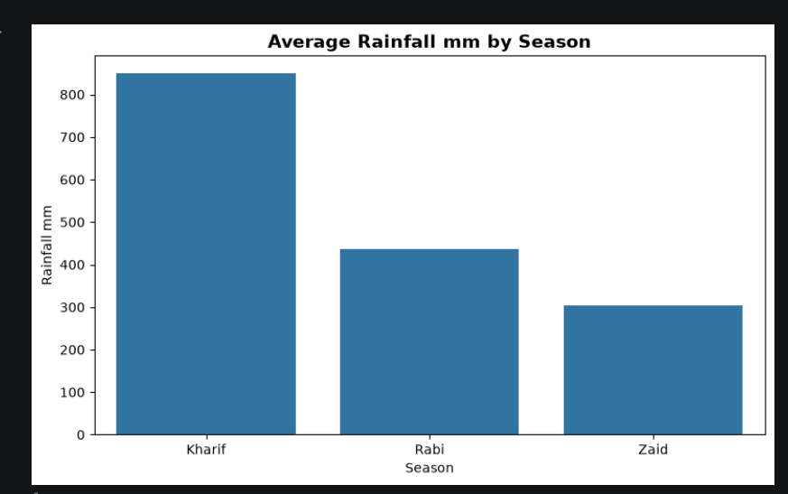
RESULTS
The bar graph shows the average rainfall in different farming seasons. Kharif receives the highest rainfall, around 850 mm, followed by Rabi with about 440 mm. Zaid receives the lowest rainfall, around 300 mm. Overall, Kharif is the rainiest season, while Zaid has the least rainfall.

Slide 11
Future scope
Predictive Analysis: Develop models to predict crop yield and agricultural performance for different seasons.
Regional Analysis: Compare seasonal performance across different geographical areas and farming conditions.
Weather Integration: Include detailed environmental and weather data to study their impact on agricultural outcomes.
Resource Optimization: Analyze resource usage and suggest better utilization across seasons.
Profit Prediction: Extend the analysis to predict seasonal profitability and identify factors affecting economic outcomes.
Interactive Dashboard: Develop a dashboard that allows farmers and planners to explore seasonal trends and performance.
Better Agricultural Planning: Use data-driven insights to support crop selection, resource planning, and seasonal decision-making.

Slide 12
GitHub Link
https://github.com/SakshiGomase14/VOIS-DataAnalytics-Internship

Slide 13

VOIS Course completion certificate - Course name- Data Visualization

Slide 14
Thank you
.
.

